Slide 1
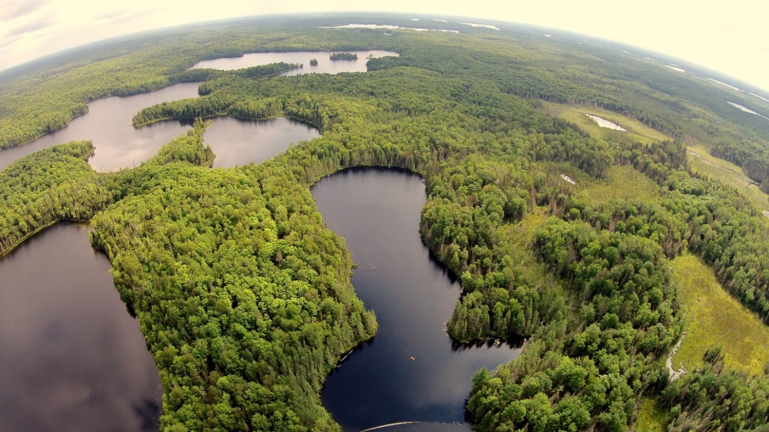
Ecological Forecasting Workshop – GLEON 21
Jake Zwart, Mary Lofton, Tadhg Moore,
Jennifer Brentrup, Ryan McClure, Cayelan Carey
Notes:
Feel free to ask questions, you can take notes, but the slides will also be posted on the github repository,

Slide 2
Agenda
How to forecast overview (~40 min)
Hands on activity in groups (~30 min) + break
Lightning talks (~30 min)
Hands on activity w/ computers (~45 min)

Slide 3

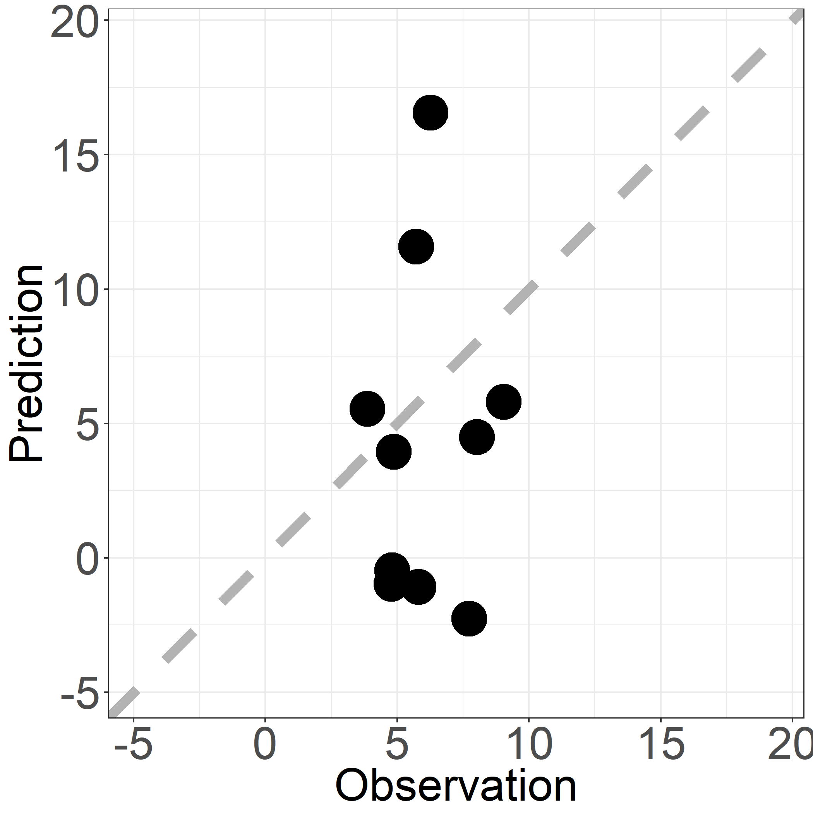


Why Forecast?
Hypothesize
Forecasts exemplify the scientific method
Analyze
Predict
Observe
Notes:
So why forecast? To me, the strongest case for forecasting is that it exemplifies the scientific method and shows promise to accelerate our science. If someone were to ask you, what is going to be the nutrient concentration in my stream 5 days from now, you would probably want to know the land cover surrounding that stream, the size of the stream, the time of year that you’re trying to forecast, the chance of rain in the next 5 days, etc… You are making hypotheses for what is important to stream nutrient concentration. Often you would turn these hypotheses into a model to make predictions for stream nutrient concentration, you would then collect out-of-sample observations over the next 5 days, and then compare to your predictions to see how well or poorly your predictions were. You would inspect your errors, make adjustments, and repeat the process over again.

Slide 4
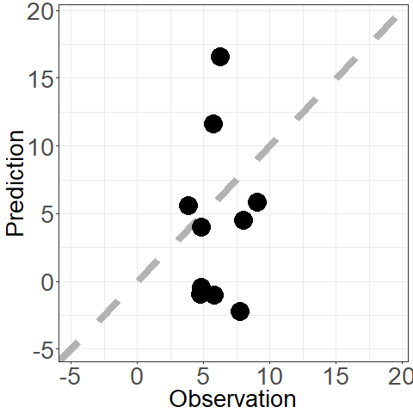
Why Forecast?
Hypothesize
Forecasts exemplify the scientific method
Analyze
Iteration
Predict
Observe
Notes:
And when done in iteration, there is great opportunity to accelerate our water quality science by repeating the scientific method over and over again. I would say that near term forecasts are not prioritized in water quality research, but has been in meterology with great success for advancing their science.

Slide 5
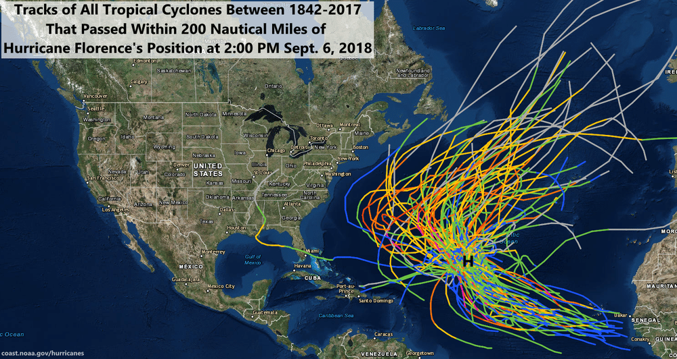
Weather Forecasting Skill
Notes:
Hurricane Florence is my favorite example of just how good weather forecasts are these days. As you probably all know, Hurricane Florence made landfall in the Carolina’s this past fall and caused major flooding and devastation. 8 days before Florence made landfall, it was out in the middle of the Atlantic and over the last 175 years, not 1 tropical cyclone in that same position made landfall anywhere in the East Coast of the US. Without computer simulations we would have very low confidence that Florence would hit the East Coast

Slide 6
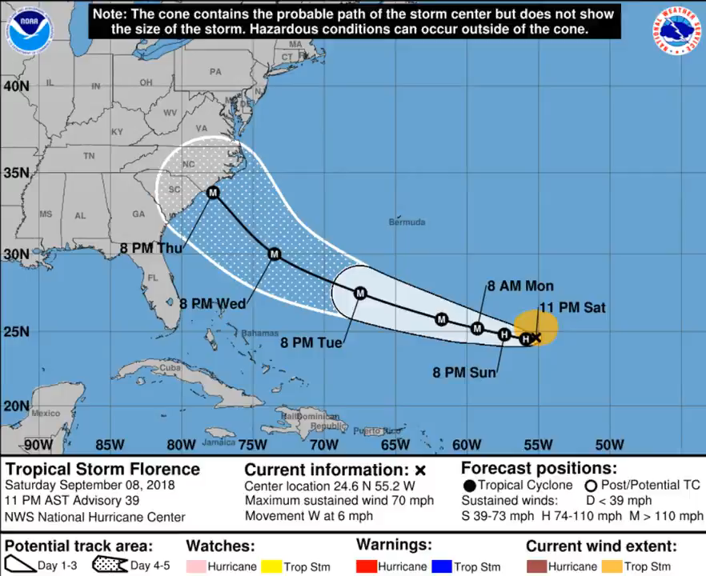
Weather Forecasting Skill
Notes:
Luckily, we do have weather forecasts and these forecasts are now extremely accurate. This video will show the track of the hurricane starting 5 days before landfall. When Florence was only a tropical storm, the mean of the ensemble forecasts were predicting a major hurricane making landfall within several miles of where it actually made landfall. This is incredible skill and was extremely valuable for decision making and protecting lives and property.

Slide 7
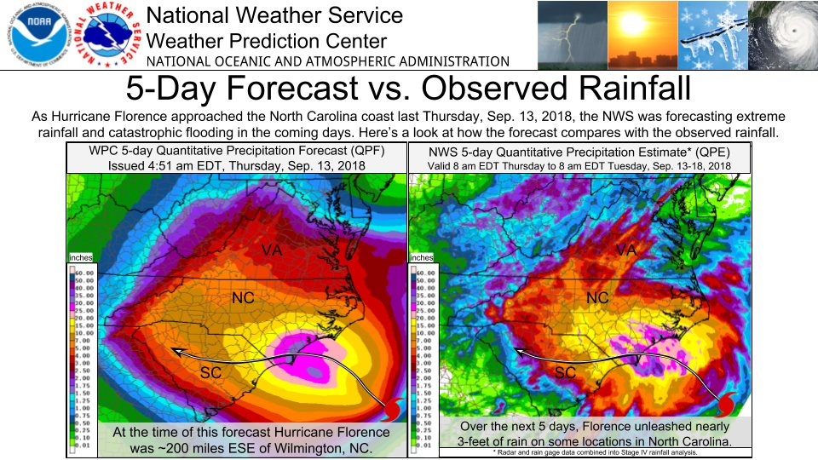
Weather Forecasting Skill
Notes:
Furthermore, at 5 days out, the models predicted that Florence would slow down considerably and dump loads of rain on the Carolina’s, which it did, and the 5 day forecasted rainfall and actual rainfall are nearly mirror images of each other. So what’s the secret? How did weather forecasting get so good?

Slide 8
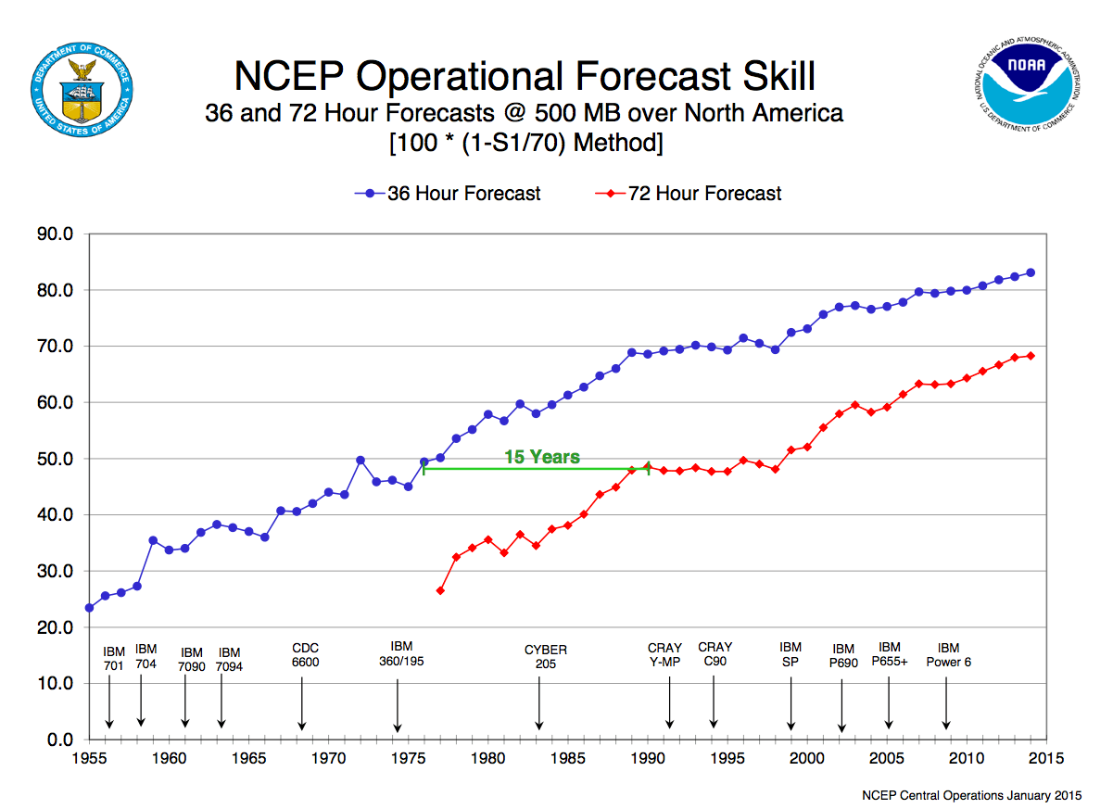
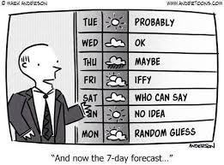
Weather Forecasting Skill
Forecast Skill
1960
1980
2000
Test predictions of how the world works multiple times per day at millions of locations
Notes:
The secret is simply that meteorologists have been forecasting for a long time, and have been repeating the forecast iteration cycle for many years. When they started, they were bad and weather forecasts were often the butt of jokes, but are now extremely reliable. And they are this good because they test predictions of how the world works 6 times per day at millions of locations.
https://www.iweathernet.com/educational/history-weather-forecasting

Slide 9
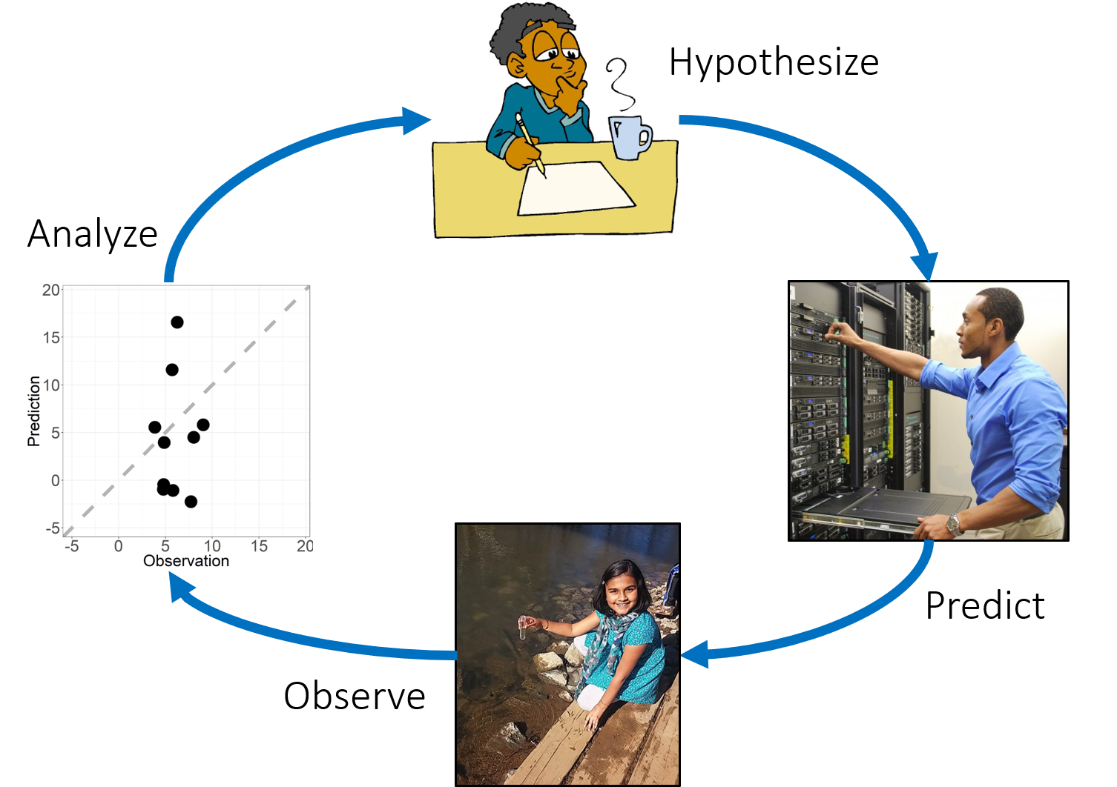
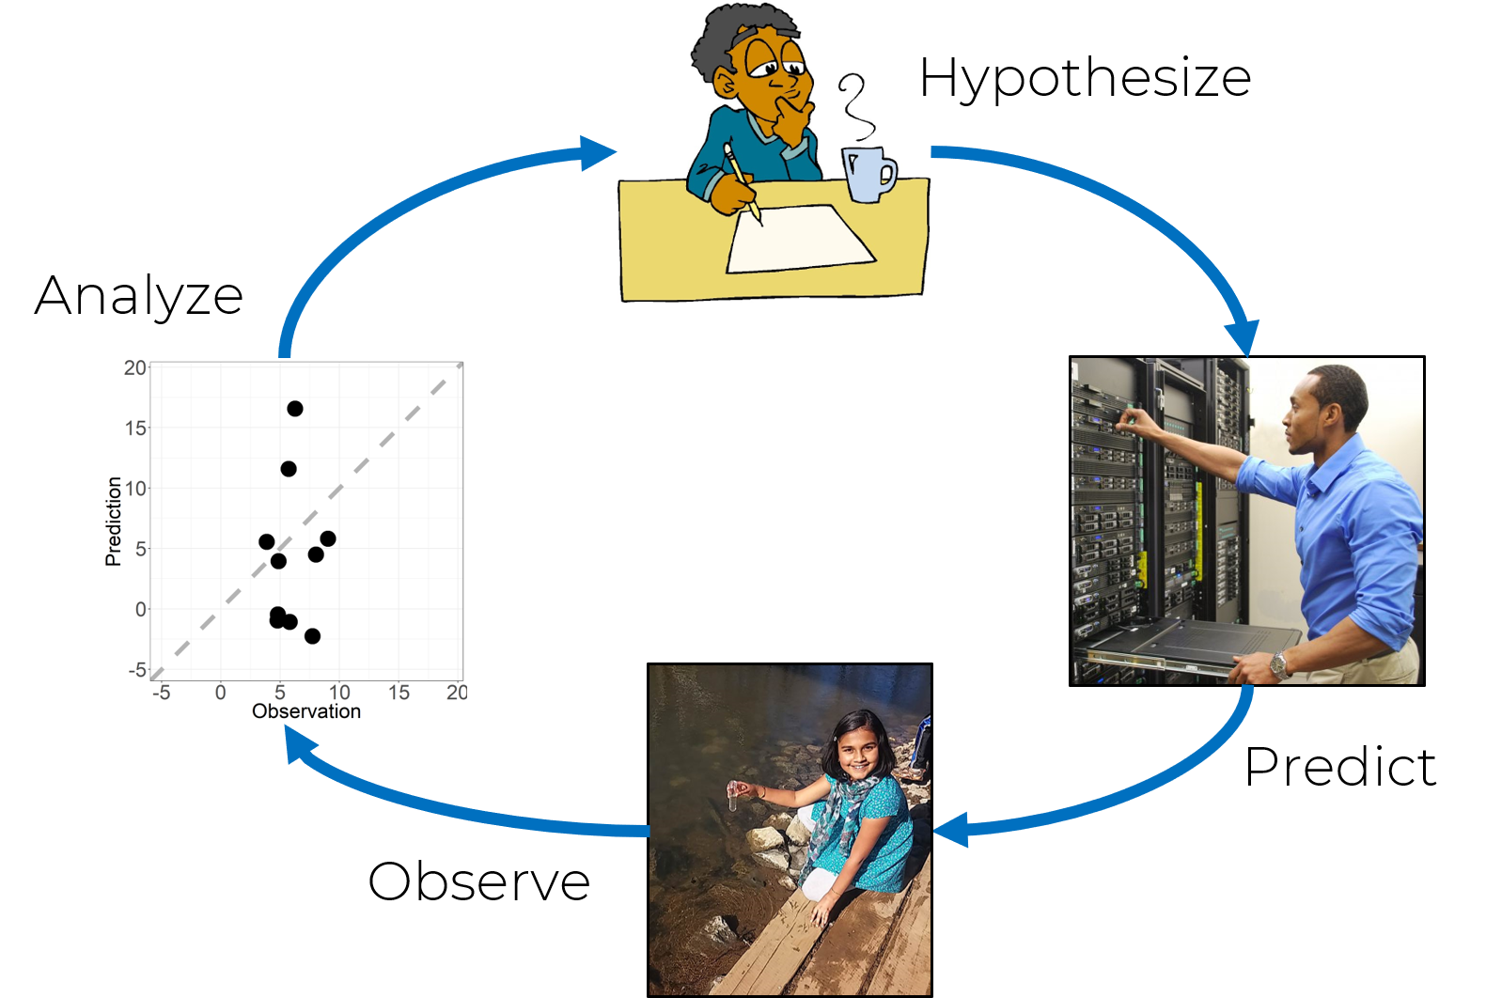
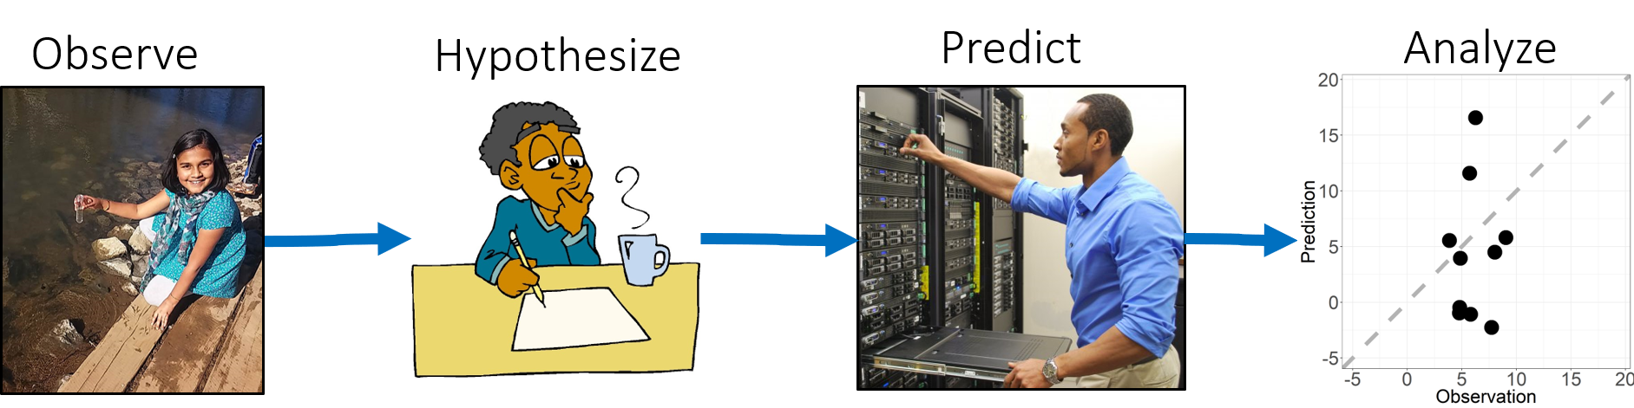
Lake Predictions
near-
term
hindcast
long-term
Today
Notes:
In contrast to weather predictions, most water quality predictions are either forecasts that are far into the future which cannot be tested, or the predictions are hindcasted and disregard contemporary water quality issues. Near-term forecasts are the sweet spot for accelerating water quality science through this scientific method iteration.

Slide 10
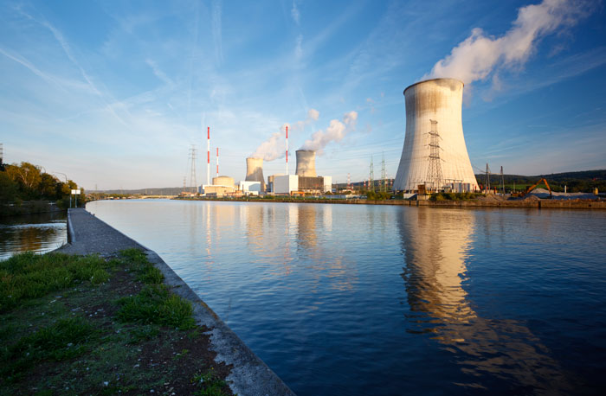
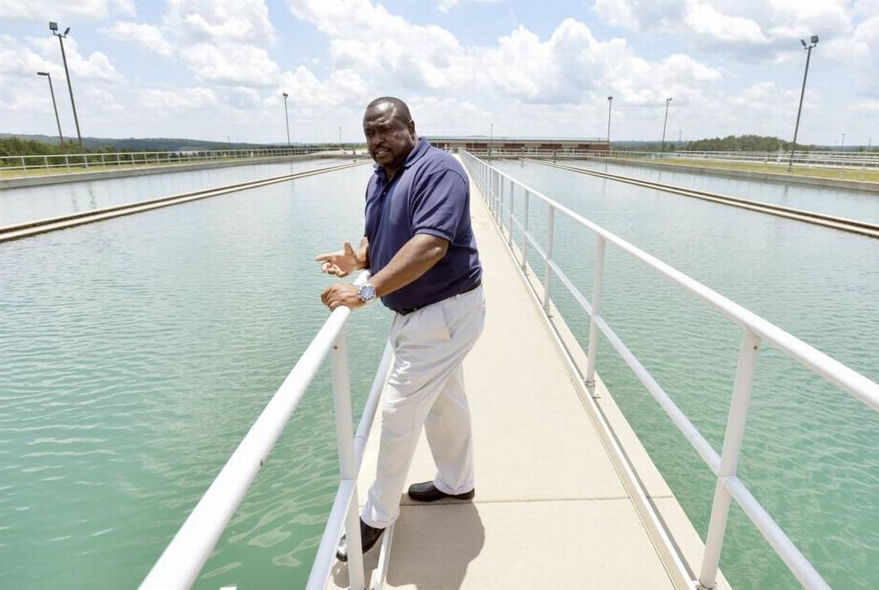
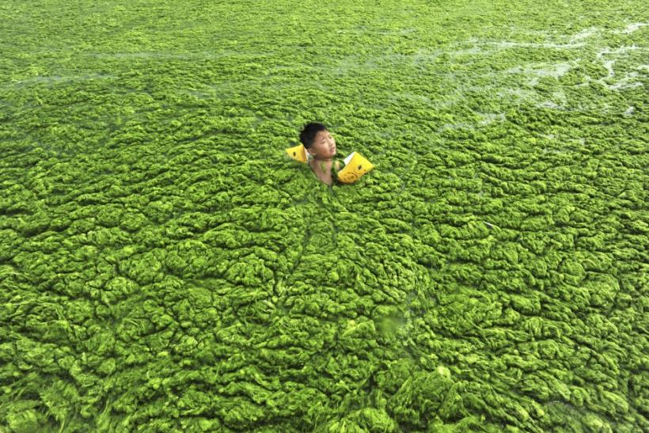
Lake Water Quality Issues are Near-Term
Will the lake be able to cool the power plant this week?
How much nitrate will be
in the water tomorrow?
Can I swim in the
lake today?
Notes:
Furthermore, many water quality issues are near term. For example, many power plants rely on natural bodies of water to cool their systems. Managers need to know if they can rely on these waters to cool the plant.
Drinking water managers need to keep concentrations below a certain level for safe drinking water.
The public relies on water bodies as a source of recreation as well. Forecasts of algae blooms well help the public decide on whether or not they can go swimming today. In this case, I guess the answer is Yes, if you’re determined enough.
Knowing about these water quality issues require near-term forecasts; however, surprisingly there are very few water near-term quality forecasts
Can I swim in a lake today? https://www.ibtimes.com/what-are-algae-blooms-why-water-green-lakes-change-colors-due-several-factors-2567403
Power plant https://cleantechnica.com/2018/01/16/increasing-renewable-energy-india-can-reduce-emissions-water-use-supply-risk/
Water quality manager: https://www.macon.com/news/local/article149688179.html

Slide 11
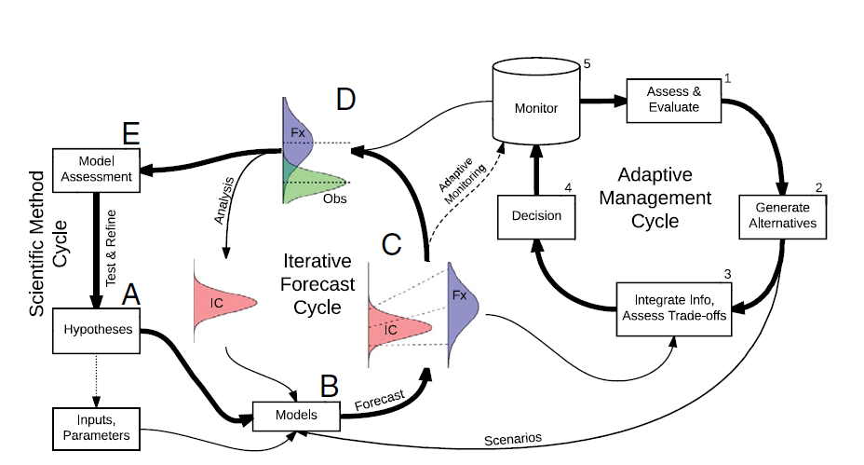
Steps to Forecasting
Know who you are forecasting for
Formulate conceptual model
Decide on extent of workflow tools
Identify potential models or build your own
Identify how you will characterize uncertainty and assimilate data
Build model database (drivers, observations, parameters)
Make forecasts!
Visualize output
Improve models and / or obs
Dietze et al. 2018 doi: 10.1073/pnas.1710231115
Notes:
From a scientists perspective

Slide 12
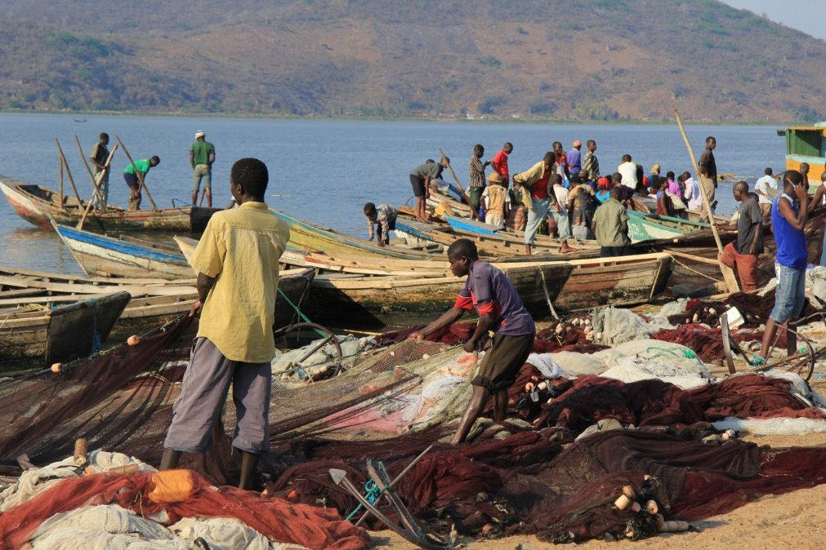
1. Know who you are forecasting for
Public
Harvesters
Modelers
Managers
Data Collectors
Notes:
Impacts your timestep, how you’ll deliver the data (viz, data file type, operational, in support of other research)

Slide 13
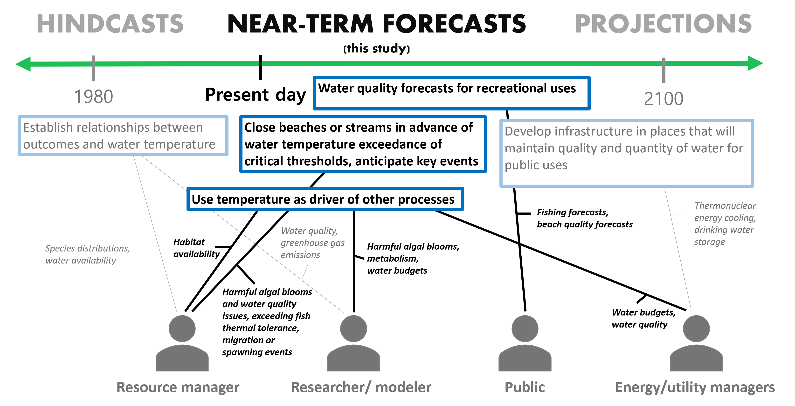
1. Know who you are forecasting for
Notes:
From a scientists perspective

Slide 14
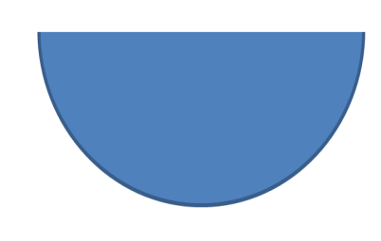

2. Formulate conceptual model
CO₂ emissions
DOC
Exude
Light
Phyto.
Respiration
GPP
DIC
GPP
Recycle
Mixed Layer
tPOC
SRP
Sedimentation
Sedimentation
Sed. Resp.
Sediments
Notes:
From a scientists perspective

Slide 15
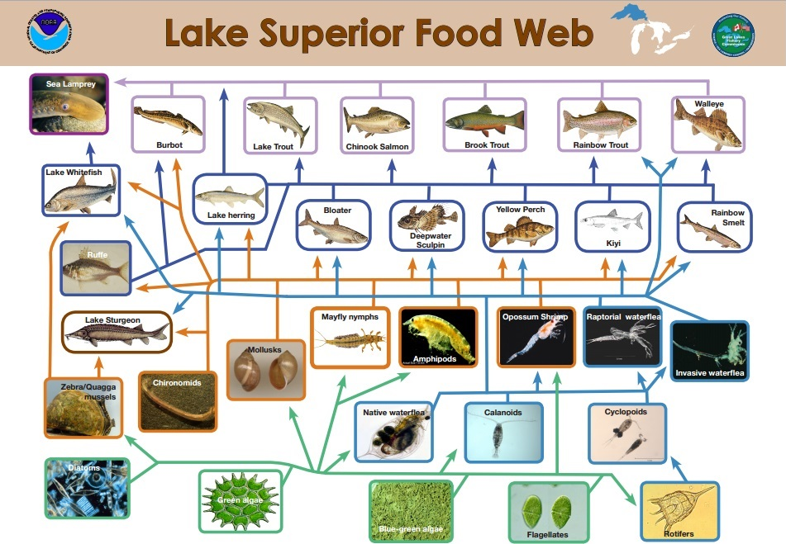
2. Formulate conceptual model
https://www.greatlakesnow.org/2018/11/prey-fish-species-in-lake-superior-are-declining/lake-superior-food-web/
Notes:
Insert fish food web.

Slide 16
3. Decide on extent of workflow tools
Democratized data analysis
External reproducibility
Reproducible, collaborative, Big Data analysis
Configuration management
Shared data storage
Dependency management with shared data storage
Dependency management
Code versioning
Efficient use of analysts' time
Reproducibility and Collaboration
HPC & HTC
Readable code
Fault tolerant batch runs
Scripted analysis
Readable file structure
Code tests
Continuous integration
Robustness to new data
Project Size (data + models + output)
https://www.usgs.gov/media/images/data-science-tools

Slide 17
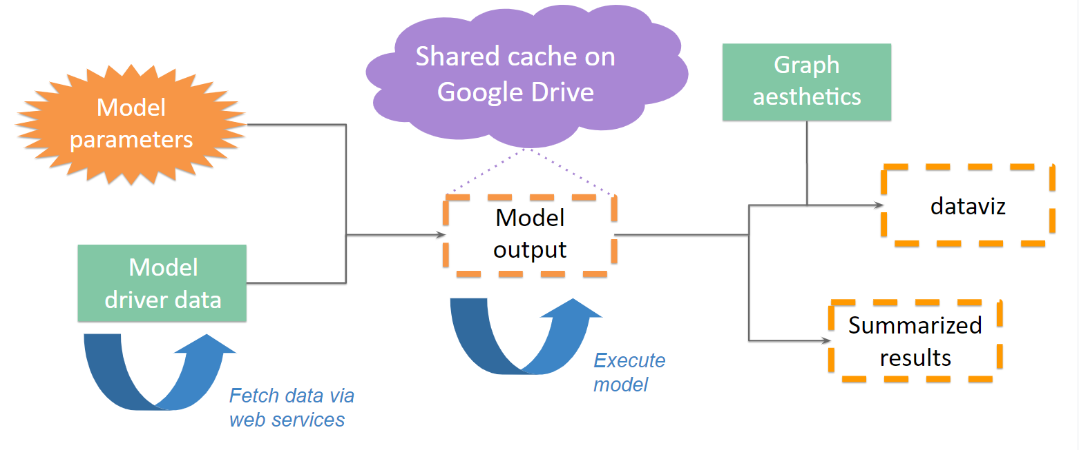
3. Decide on extent of workflow / pipeline
Lindsay Platt et al. 2019
Notes:
Insert fish food web.

Slide 18
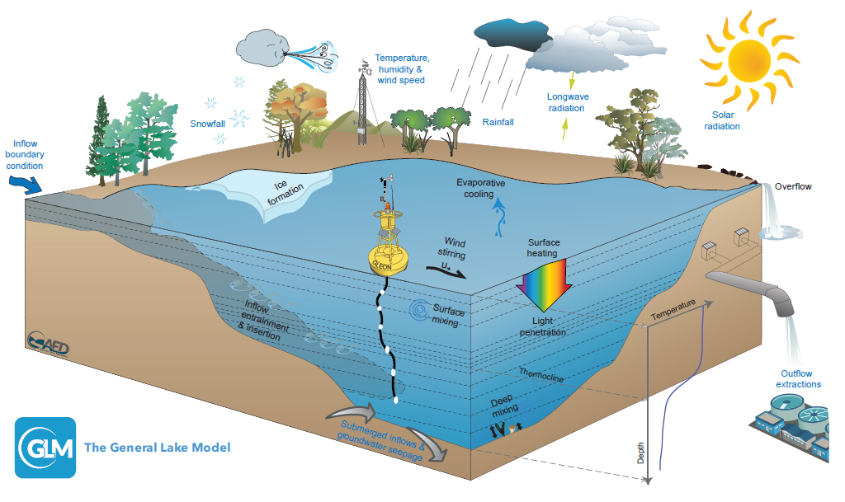
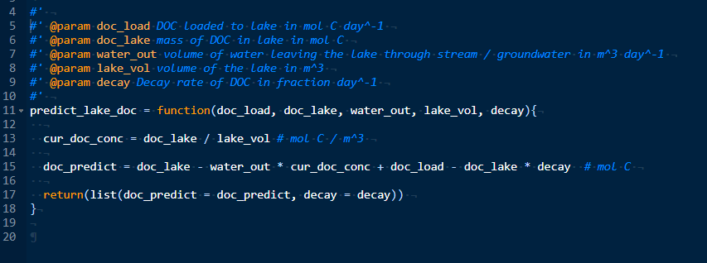
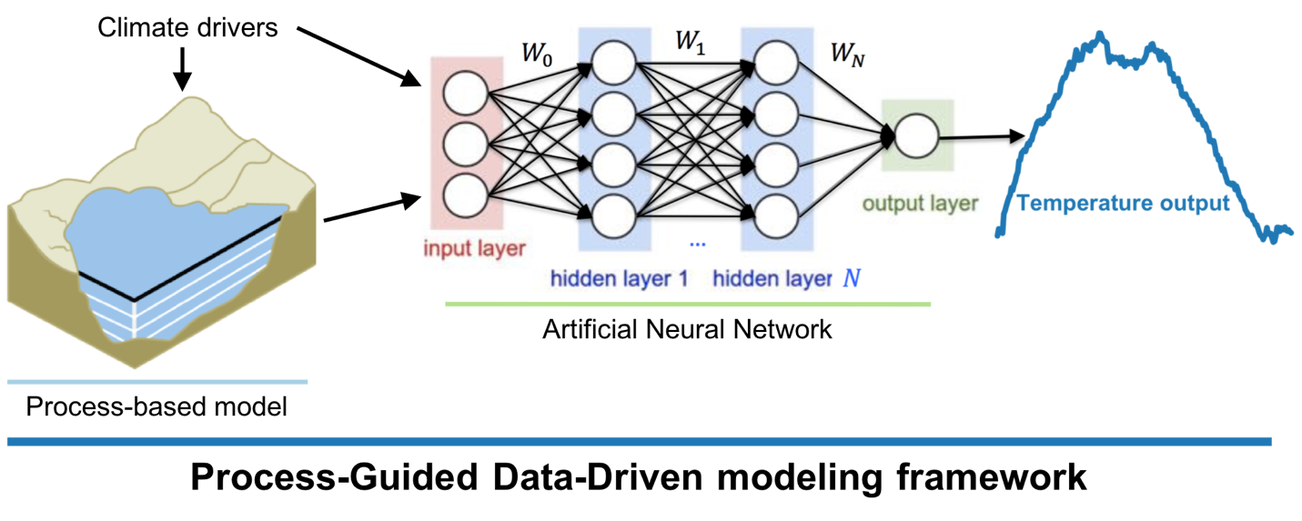
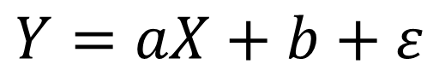
4. Identify potential models or build your own
Hipsey et al. 2019
Weather
$$Y=aX+b+ε$$
Lake properties
Notes:
Insert fish food web.

Slide 19
4. Identify potential models or build your own
Can you start and stop the model?
Can you change the initialization?
How fast does it run?
How many parameters and drivers does it require?
Hipsey et al. 2019
Notes:
Insert fish food web.

Slide 20
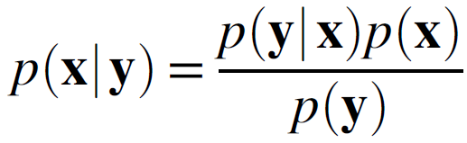
5. Identify how you will characterize uncertainty and assimilate data
Think Distributions
Sources of uncertainty
Initial conditions
External drivers
Model parameters
Model process
Model structure
Observations
Obs
Model
t
t + 1
Update

Slide 21
5. Identify how you will characterize uncertainty and assimilate data
Uncertainty propagation
 | Distribution | Moments
Analytical | Variable transform | Analytical moments
Numerical | Monte Carlo | Ensembles

Slide 22
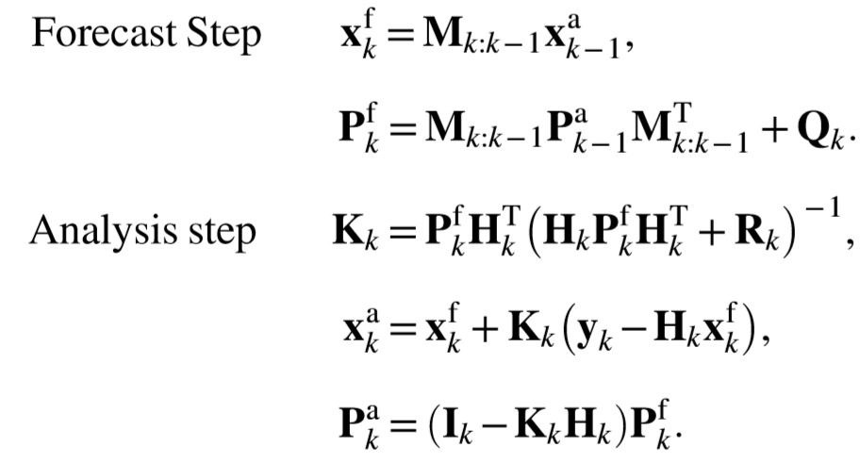
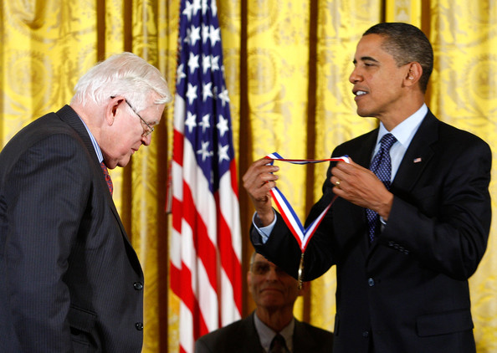
5. Identify how you will characterize uncertainty and assimilate data
Analytical moments (Kalman filter)
Assumptions: linear dynamical and observational models, gaussian error distributions
Cassari et al. 2017 doi: 10.1002/wcc.535
Notes:
https://www.google.com/url?sa=i&source=images&cd=&ved=2ahUKEwjEnPD43svlAhVEUt8KHZYJD68QjRx6BAgBEAQ&url=http%3A%2F%2Fwww.zimbio.com%2Fphotos%2FBarack%2BObama%2FRudolf%2BKalman%2FObama%2BAwards%2BNational%2BMedals%2BScience%2BTechonology%2FI4RES3FoXgm&psig=AOvVaw3Sr2UFlfURYg_YKYL78obO&ust=1572791467782312

Slide 23
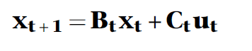
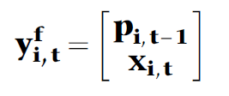
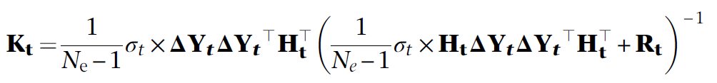
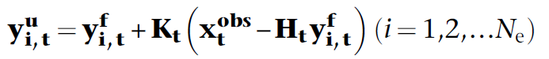
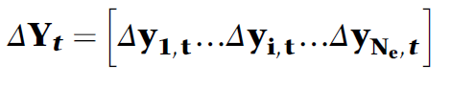
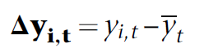
5. Identify how you will characterize uncertainty and assimilate data
Numerical moments (Ensemble Kalman filter)
Assumptions: gaussian error distributions
where:
Cassari et al. 2017 doi: 10.1002/wcc.535; Zwart et al. 2019; Evensen 1994

Slide 24



5. Identify how you will characterize uncertainty and assimilate data
Numerical moments (Ensemble Kalman filter)
Assumptions: gaussian error distributions
Pros:
Good for non-linear models
Simple to implement
Adding sources of error is easy
Cons:
Gaussian error assumption
Slower than analytical moments
Cassari et al. 2017 doi: 10.1002/wcc.535; Zwart et al. 2019; Evensen 1994; thenounproject.com

Slide 25
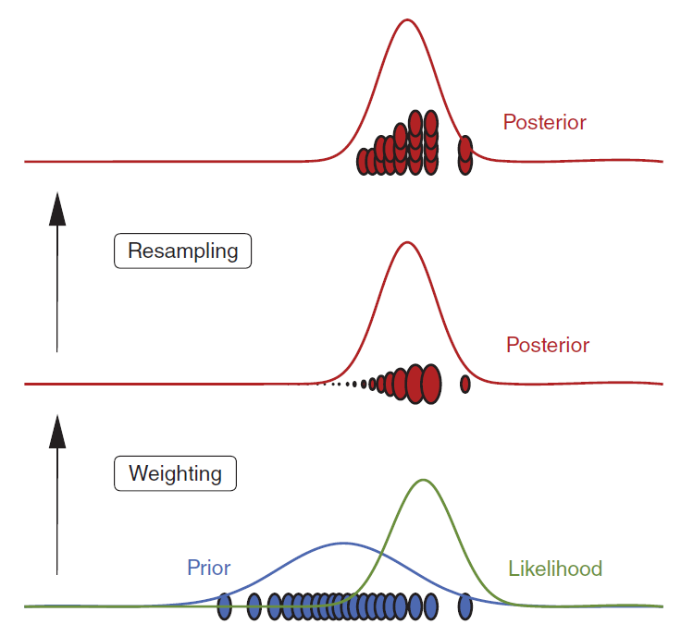
5. Identify how you will characterize uncertainty and assimilate data
Numerical distribution (Particle filter)
Pros:
Good for non-linear models
Simple to implement
Adding sources of error is easy
Fully Bayesian
Cons:
Slow
Cassari et al. 2017 doi: 10.1002/wcc.535

Slide 26
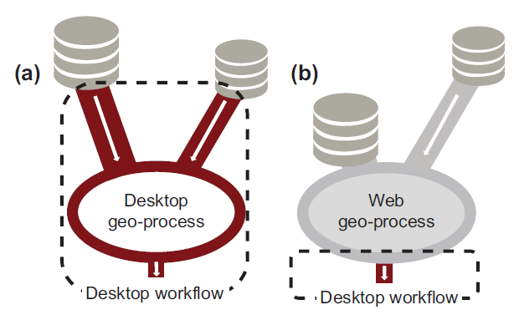



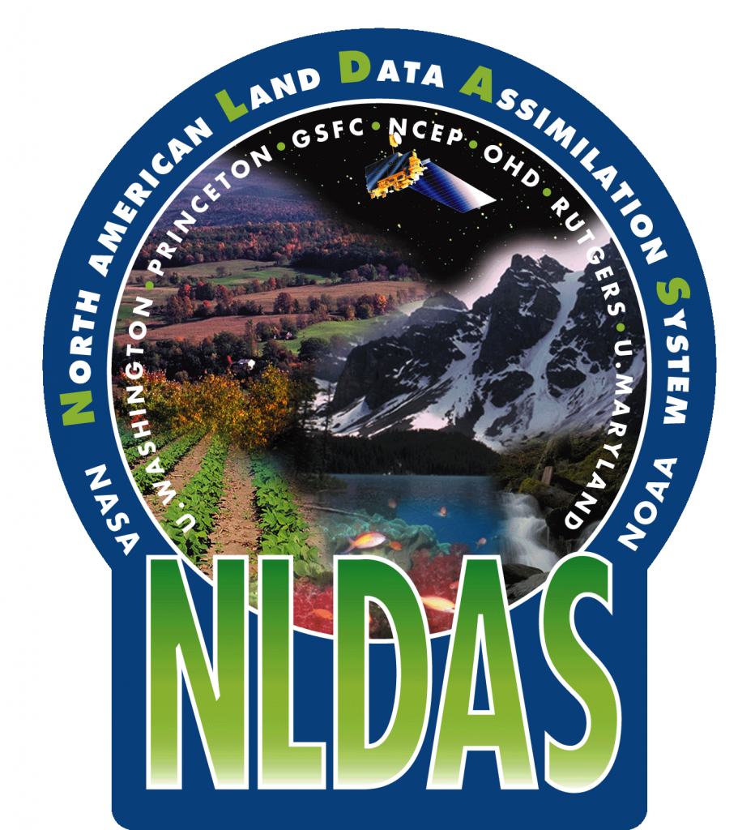

6. Build model database (drivers, observations, parameters)
Sources
Storage
Read et al. 2015 doi: 10.1111/ecog.01880

Slide 27

6. Build model database (drivers, observations, parameters, output)
Common data standards
Naming examples
snowpack_bottom__temperature
channel_bottom_water_flow__speed
chocolate__thermal_diffusivity
https://csdms.colorado.edu/wiki/Main_Page;
https://bmi-spec.readthedocs.io/en/latest/

Slide 28
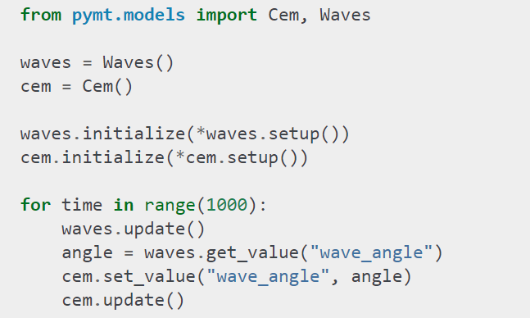

6. Build model database (drivers, observations, parameters, output)
Common data standards
Basic Model Interface
https://csdms.colorado.edu/wiki/Main_Page;
https://bmi-spec.readthedocs.io/en/latest/

Slide 29
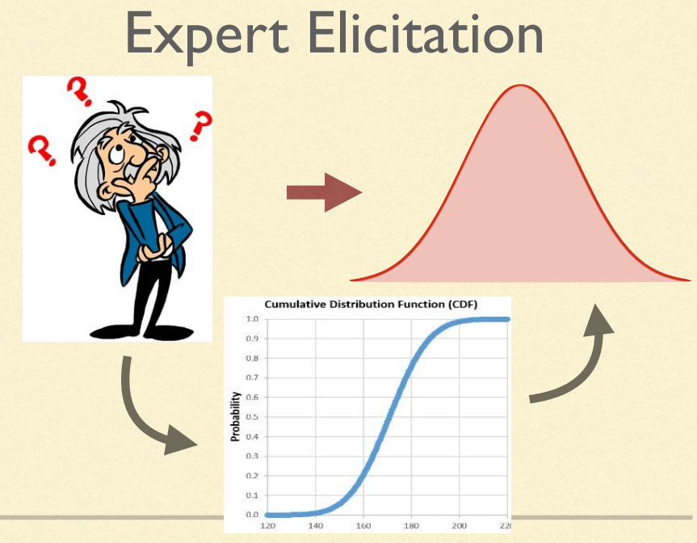
6. Build model database (drivers, observations, parameters, output)
Assigning uncertainty
https://ecoforecast.org/wp-content/uploads/2019/07/05_Scenarios.pdf

Slide 30
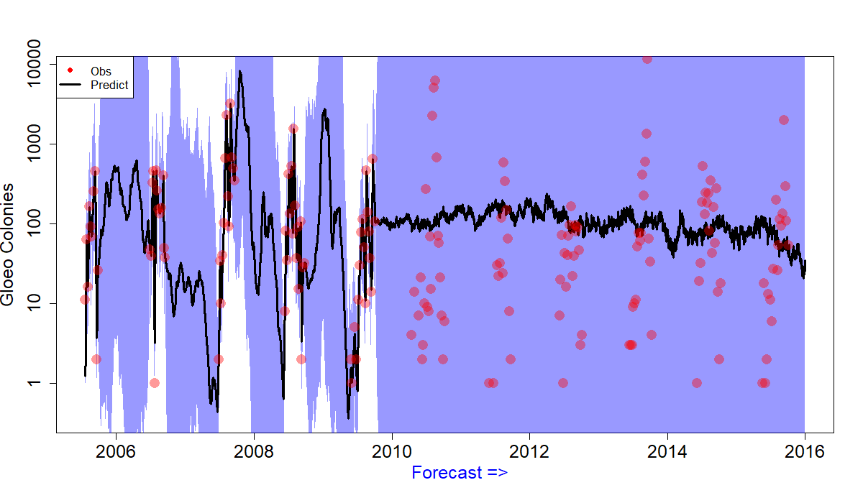
7. Make forecasts!

Slide 31
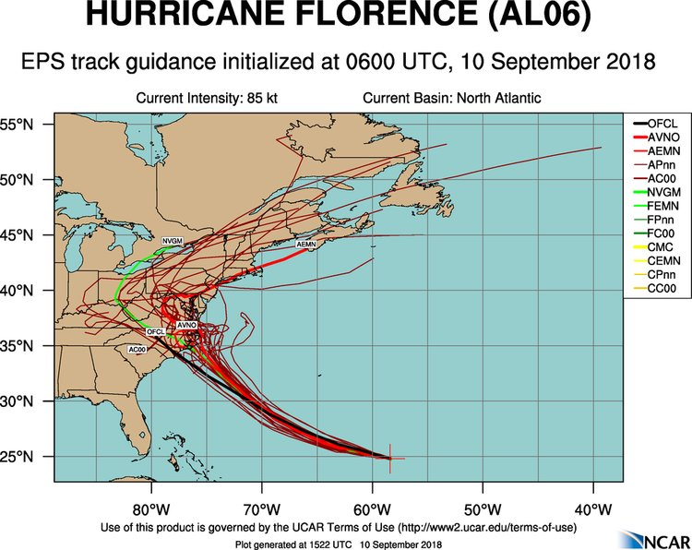
8. Visualize output

Slide 32
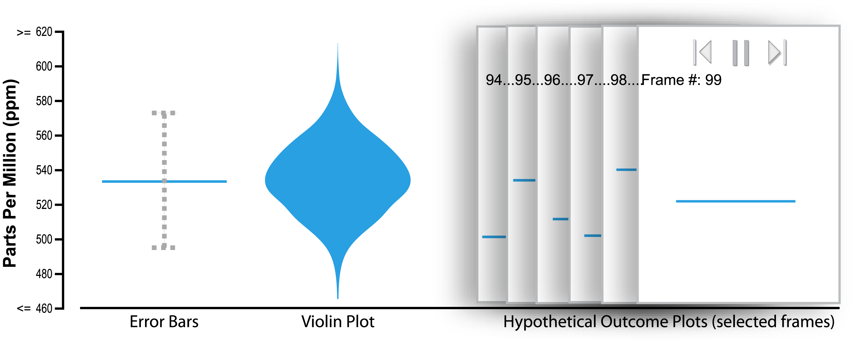
8. Visualize output
Hypothetical outcome plot
Hullman et al. 2015 doi: 10.1371/journal.pone.0142444

Slide 33

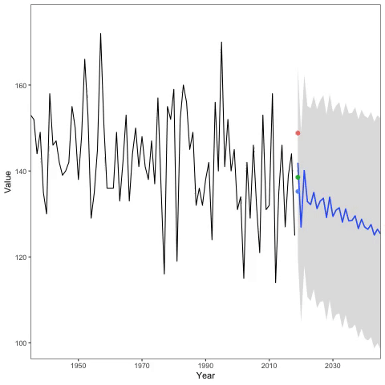

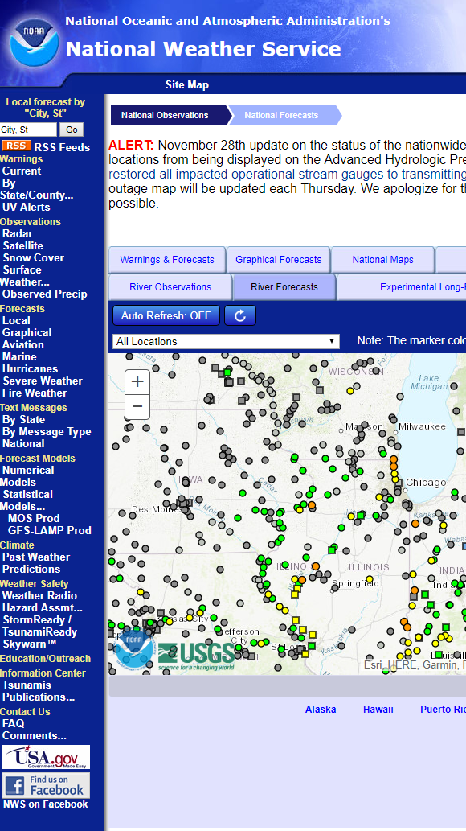
8. Visualize output
Hypothetical outcome plot
https://twitter.com/oecodynamics/status/1082226682164101122?s=20

Slide 34
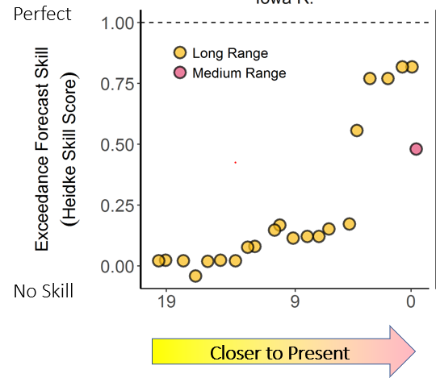
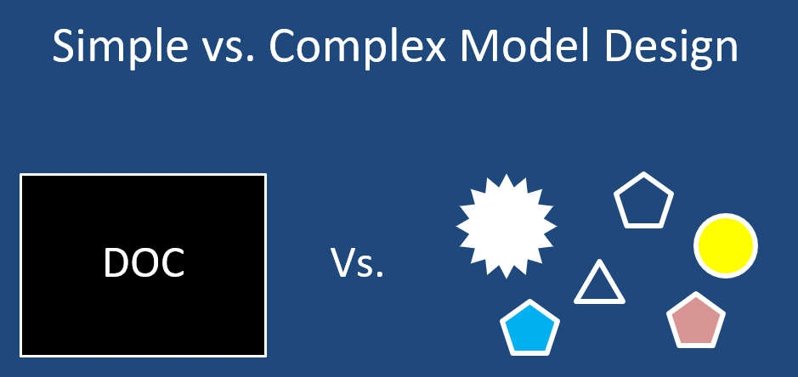
9. Improve models and / or observations
Zwart et al. 2019

Slide 35
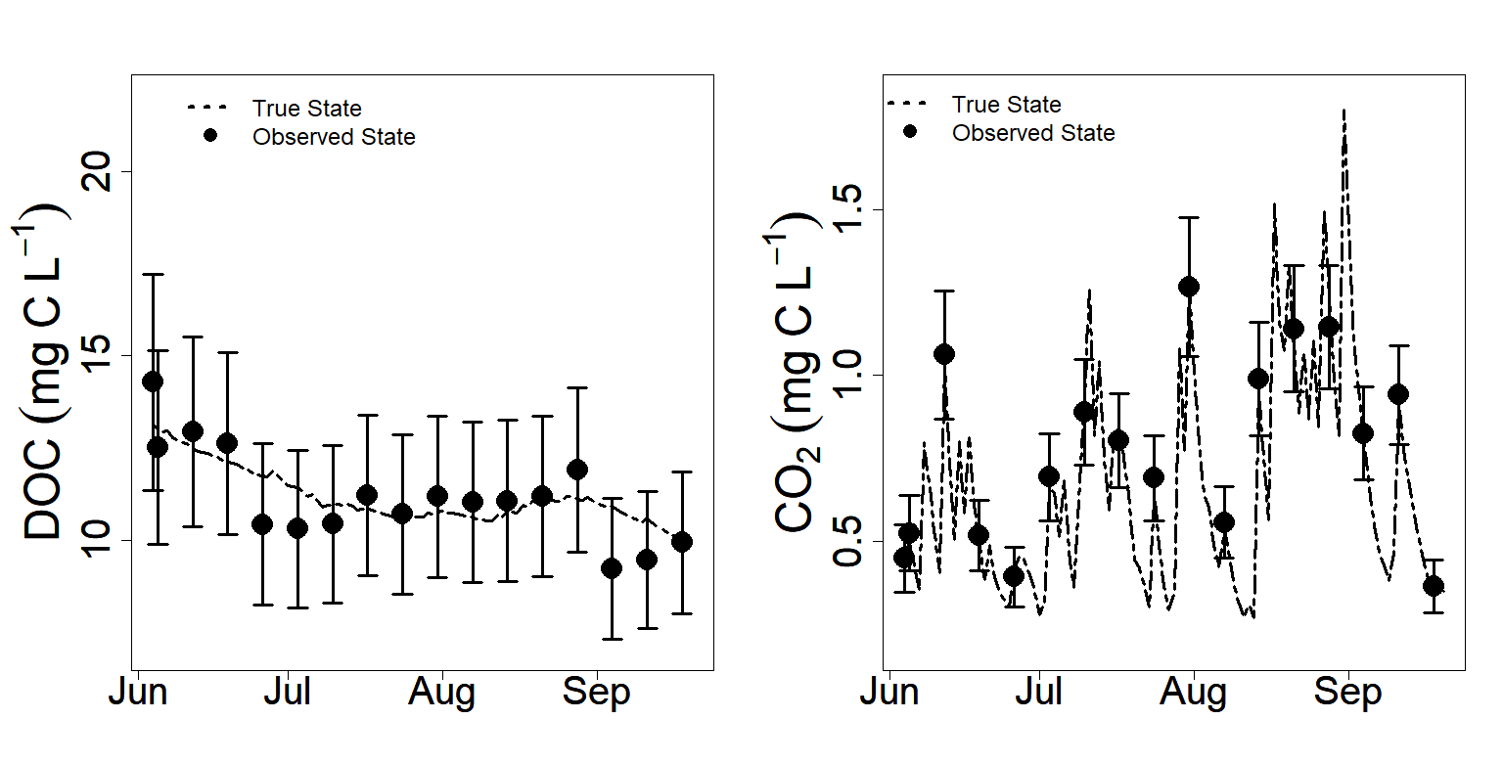
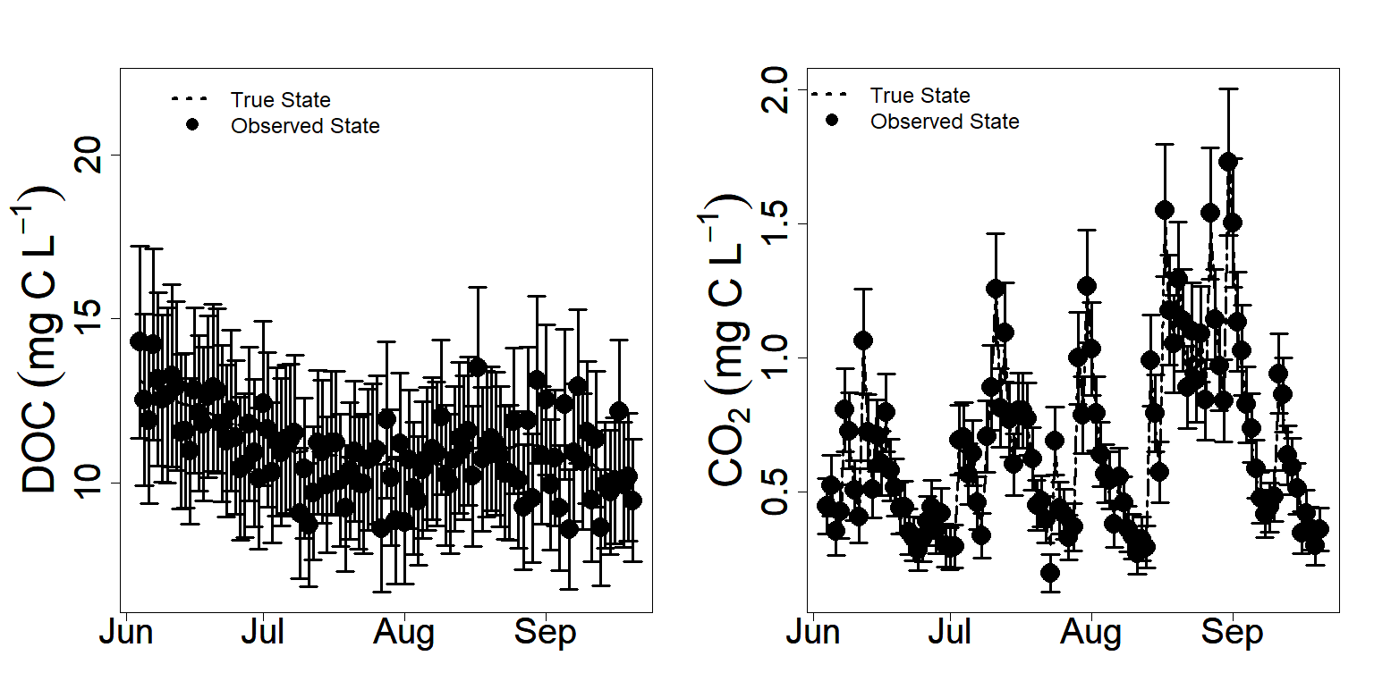
9. Improve models and / or observations
Observing System Simulation Experiments
Zwart et al. 2019

Slide 36
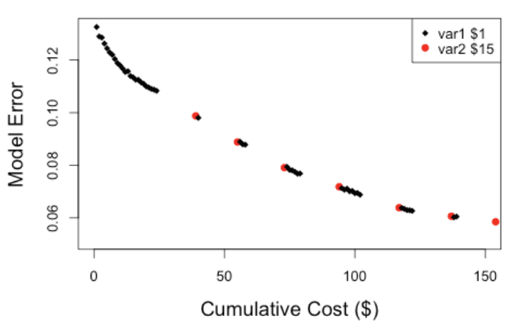
9. Improve models and / or observations
https://ecoforecast.wordpress.com/summer-course/summer-course-2018/

Slide 37
Steps to Forecasting
Know who you are forecasting for
Formulate conceptual model
Decide on extent of workflow tools
Identify potential models or build your own
Identify how you will characterize uncertainty and assimilate data
Build model database (drivers, observations, parameters)
Make forecasts
Visualize output
Improve models and / or obs
Dietze et al. 2018 doi: 10.1073/pnas.1710231115
Notes:
From a scientists perspective

Slide 38
Pick a variable to forecast
Water temperature
Dissolved organic carbon
Phosphorus
Nitrogen
Dissolved oxygen
Water clarity
Lake level / stage
Salmon/eel migrations
Zooplankton
Methane
Chl-a
Cyanobacteria

Slide 39
In groups, discuss how to forecast ____
What stakeholders should you be engaged with? What questions might they be interested in?
How far out would you forecast?
What data would you need to forecast?
What modeling methods might you use?
What would contribute to uncertainty in your forecast?
10:25am – BREAK!
10:30am – share with neighboring group
10:45am – lightning talks

Slide 40
Steps to Forecasting
Know who you are forecasting for
Formulate conceptual model
Decide on extent of workflow tools
Identify potential models or build your own
Identify how you will characterize uncertainty and assimilate data
Build model database (drivers, observations, parameters)
Make forecasts
Visualize output
Improve models and / or obs
Dietze et al. 2018 doi: 10.1073/pnas.1710231115
Notes:
From a scientists perspective

Slide 42
Hands-on activity – Forecasting DOC
https://github.com/gsagleon/G21_GSA_workshop
https://github.com/gsagleon/G21_GSA_workshop/blob/master/A_EcoForecast/hands_on_activity.pdf

Slide 43
Forecasting Resources
Workshop materials: https://github.com/gsagleon/G21_GSA_workshop
Ecological Forecasting Initiative (ecoforecast.org)

